Slide 1

Domain ML
Technology: Python
Revolutionizing neurodegenerative disease treatment with deep learning models

Slide 2
INDEX
    Implementation
      Data Description
    Model Implementation
      Algorithm Definition
      working Process
      Results from Algorithm
    Performance comparison
    Output Screens
    Future Scope
    Conclusion
    Project Description
    Problem Statement
    Objective
    Scope
    Proposed System
    Literature Survey
    Architecture
    UML Diagrams
    Resource Requirements

Slide 3
ABSTRACT
This research explores the application of deep learning models, particularly Convolutional Neural Networks (CNNs) and hybrid algorithms, in revolutionizing the treatment and diagnosis of neurodegenerative diseases. The study utilizes a dataset from Kaggle, which contains comprehensive data related to neurodegenerative conditions, to train and evaluate various machine learning models. The models aim to classify different stages or types of neurodegenerative diseases, facilitating early diagnosis and personalized treatment. Advanced architectures, such as MobileNet, are also implemented to enhance the performance and efficiency of the model, particularly for mobile and edge computing environments. The frontend of the system is developed using HTML, CSS, and JavaScript, while Python is employed for the backend model training and deployment. This approach seeks to improve the accuracy, speed, and accessibility of neurodegenerative disease diagnosis, offering significant potential for healthcare innovation.
Keywords: Neurodegenerative diseases, deep learning, Convolutional Neural Networks (CNN), hybrid algorithms, MobileNet, classification, dataset, diagnosis, healthcare, machine learning.

Slide 4
    OBJECTIVE OF PROJECT
The primary objective of this research is to develop and evaluate deep learning models, particularly Convolutional Neural Networks (CNNs) and hybrid algorithms, to classify different stages or types of neurodegenerative diseases based on available medical datasets. The study also aims to implement advanced architectures, such as MobileNet, to optimize the performance and efficiency of these models, especially for deployment in mobile and edge computing environments. Furthermore, the research seeks to explore the potential of integrating AI-based models with healthcare systems, aiming to improve diagnostic accuracy, speed, and accessibility. The ultimate goal is to create an automated system that can assist healthcare professionals in early diagnosis and personalized treatment planning for neurodegenerative diseases.

Slide 5
    PROBLEM STATEMENT
Neurodegenerative diseases are complex, with symptoms that develop slowly over time, making early diagnosis and effective monitoring challenging. Current diagnostic methods often require subjective judgment, lengthy testing procedures, and high resource consumption, leading to delays in identifying the condition or its stage. These challenges hinder timely interventions, which are crucial for improving patient outcomes. Traditional methods also struggle to scale, particularly in resource-limited settings. With the increasing availability of health data, there is a need for advanced AI-driven models capable of automating disease detection and classification, providing faster and more accurate diagnoses. This study aims to address these challenges using deep learning techniques to enhance neurodegenerative disease diagnosis.

Slide 6
    MOTIVATION
Neurodegenerative diseases, such as Alzheimer's and Parkinson's, represent a significant burden on healthcare systems worldwide. Early diagnosis and personalized treatment are crucial in managing these conditions effectively, yet traditional diagnostic methods can be slow and often require invasive procedures. The rise of deep learning models, particularly Convolutional Neural Networks (CNNs), presents an opportunity to automate and enhance the accuracy of neurodegenerative disease diagnosis. This research is motivated by the need to accelerate and improve diagnostic processes, leveraging AI to identify disease patterns in medical data that are not immediately apparent to human clinicians. By integrating cutting-edge technologies into both mobile and healthcare environments, the study aims to create a more accessible, efficient, and accurate solution for neurodegenerative disease diagnosis.

Slide 7
SCOPE
The scope of this research includes the development and evaluation of deep learning models, particularly CNNs and hybrid algorithms, for diagnosing neurodegenerative diseases using a Kaggle dataset. The models will be designed to classify various stages or types of neurodegenerative diseases, facilitating early detection and intervention. The study also explores the use of advanced model architectures, like MobileNet, to improve performance in mobile and edge computing environments. While focusing on backend model development with Python, the research also includes the design of a frontend interface using HTML, CSS, and JavaScript to enable user interaction. The scope extends to enhancing the accuracy, speed, and scalability of disease diagnosis, contributing to healthcare innovation.

Slide 8
INTRODUCTION
Neurodegenerative diseases, such as Alzheimer's, Parkinson's, and Huntington's, are a growing global health concern, affecting millions of individuals worldwide. These diseases are characterized by the gradual degeneration of nerve cells, leading to cognitive, motor, and behavioral impairments. Early and accurate diagnosis is critical to managing these conditions, as early intervention can significantly improve the quality of life for patients and provide opportunities for personalized treatment strategies. However, traditional diagnostic methods, including clinical assessments and imaging techniques, are often time-consuming, expensive, and can be subject to human error.
Recent advancements in artificial intelligence, particularly deep learning, have opened up new possibilities for automating and enhancing the diagnosis of neurodegenerative diseases. medical data related to these diseases.

Slide 9
Convolutional Neural Networks (CNNs), a class of deep learning models, have shown remarkable success in image and pattern recognition tasks, making them ideal for analyzing.
This research investigates the application of CNNs and hybrid machine learning algorithms to classify various stages and types of neurodegenerative diseases, using a dataset from Kaggle containing comprehensive medical data. The study also explores the integration of advanced architectures like MobileNet to optimize model performance, particularly for mobile and edge computing environments, ensuring accessibility and efficiency. By combining these technologies with an intuitive frontend, the aim is to revolutionize neurodegenerative disease diagnosis, enhancing both accuracy and speed for healthcare professionals.

Slide 10
    LITERATURE SURVEY
Year | Author(s) | Title | Description
2020 | Lee & Kim | Application of CNNs in Neuroimaging | Early diagnosis of neurodegenerative diseases using CNNs.
2021 | Patel & Singh | Machine Learning for Personalized Treatment | Machine learning models for personalized treatment of neurodegenerative diseases.
2021 | Gupta et al. | MobileNet for Edge Device Classification | Classification of healthcare data using MobileNet on edge devices.
2022 | Smith & Johnson | Hybrid Algorithms for Parkinson’s Classification | Hybrid machine learning algorithms for Parkinson’s disease detection.
2023 | Zhang et al. | Deep Learning for Alzheimer’s Diagnosis | Deep learning models applied to Alzheimer’s disease diagnosis.

Slide 11
    LITERATURE SURVEY
Year | Author(s) | Title | Description
2020 | Lee & Kim | Application of CNNs in Neuroimaging | Early diagnosis of neurodegenerative diseases using CNNs.
2021 | Patel & Singh | Machine Learning for Personalized Treatment | Machine learning models for personalized treatment of neurodegenerative diseases.

Slide 12
    EXISTING SYSTEM
The existing systems for diagnosing neurodegenerative diseases rely heavily on traditional methods, such as manual assessments, neuroimaging, and clinical evaluations. These processes often involve subjective interpretations by healthcare professionals, leading to variability in diagnoses. Furthermore, they are time-consuming, require extensive resources, and may lack precision in identifying early stages of diseases. Although some machine learning models have been used, they are often not optimized for efficiency or scalability, especially in mobile and edge computing environments. Traditional systems also struggle with handling large, complex datasets efficiently, limiting their ability to provide real-time, personalized diagnostic solutions. As a result, these systems may delay early diagnosis, impacting patient care and outcomes.

Slide 13
DISADVANTAGES
Increased Accuracy: Deep learning models like CNNs offer more accurate diagnoses by detecting patterns in data that may be missed by human clinicians.
Faster Diagnosis: The system can provide near-instantaneous results, reducing the time required for diagnosis compared to traditional methods.
Personalized Treatment: Early and precise classification of neurodegenerative diseases allows for tailored treatment plans for patients.
Scalability: The system is optimized for mobile and edge environments, making it easily accessible and scalable in various healthcare settings.
Automated Process: Reduces the reliance on human intervention, minimizing the risk of errors and ensuring consistent diagnoses.

Slide 14
    PROPOSED SYSTEM
The proposed system utilizes deep learning models, particularly Convolutional Neural Networks (CNNs), to automate and enhance the diagnosis of neurodegenerative diseases. By leveraging a dataset from Kaggle, it aims to classify various stages and types of these diseases with high accuracy. Hybrid algorithms are employed to improve model performance, and MobileNet architecture is implemented to optimize the system for mobile and edge computing environments, enhancing both speed and efficiency. The frontend is developed using HTML, CSS, and JavaScript, while the backend utilizes Python for model training and deployment. This approach aims to improve diagnostic accuracy, speed, and accessibility, offering significant potential for healthcare innovation, particularly in real-time and remote diagnostics.

Slide 15
ADVANTAGES
Increased Accuracy: Deep learning models like CNNs offer more accurate diagnoses by detecting patterns in data that may be missed by human clinicians.
Faster Diagnosis: The system can provide near-instantaneous results, reducing the time required for diagnosis compared to traditional methods.
Personalized Treatment: Early and precise classification of neurodegenerative diseases allows for tailored treatment plans for patients.
Scalability: The system is optimized for mobile and edge environments, making it easily accessible and scalable in various healthcare settings.
Automated Process: Reduces the reliance on human intervention, minimizing the risk of errors and ensuring consistent diagnoses.

Slide 16
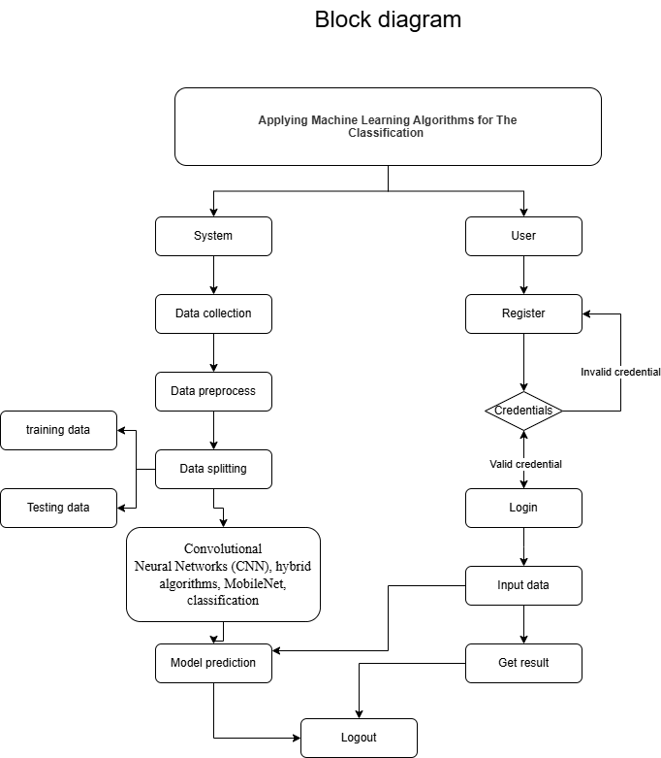
BLOCK DIAGRAM

Slide 17
Resource Requirements
Hardware
Processor: I5/Intel Processor, RAM: 8GB (min), Hard Disk: 128 GB, Key Board: Standard Windows Keyboard, Mouse: Two or Three Button Mouse)
01
Resources
02
Software
(Operating System: Windows 10, Programming Language: Python 3.10.8, IDE: VS Code)
03
Packages/Libraries
(Streamlit, Sklearn, Transformers, Tensorflow, Pandas, Seaborn, Speech Recognition

Slide 18
FUNCTIONAL AND NON-FUNCTIONAL REQUIREMENTS
Requirement’s analysis is very critical process that enables the success of a system or software project to be assessed. Requirements are generally split into two types: Functional and non-functional requirements.
Functional Requirements: These are the requirements that the end user specifically demands as basic facilities that the system should offer. All these functionalities need to be necessarily incorporated into the system as a part of the contract. These are represented or stated in the form of input to be given to the system, the operation performed and the output expected. They are basically the requirements stated by the user which one can see directly in the final product, unlike the non-functional requirements.

Slide 19
FUNCTIONAL AND NON-FUNCTIONAL REQUIREMENTS
Examples of functional requirements:
Authentication of user whenever he/she logs into the system
System shutdown in case of a cyber-attack
A verification email is sent to user whenever he/she register for the first time on some software system.
Non-functional requirements: These are basically the quality constraints that the system must satisfy according to the project contract. The priority or extent to which these factors are implemented varies from one project to other. They are also called non-behavioral requirements.

Slide 20
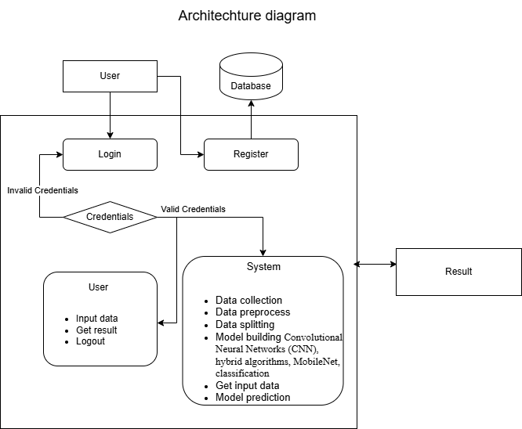
ARCHITECTURE

Slide 21
Use Case Diagram:
1) A use case diagram in the Unified Modeling Language (UML) is a type of behavioral diagram defined by and created from a Use-case analysis.
2) Its purpose is to present a graphical overview of the functionality provided by a system in terms of actors, their goals (represented as use cases), and any dependencies between those use cases.
3) The main purpose of a use case diagram is to show what system functions are performed for which actor. Roles of the actors in the system can be depicted.

Slide 22
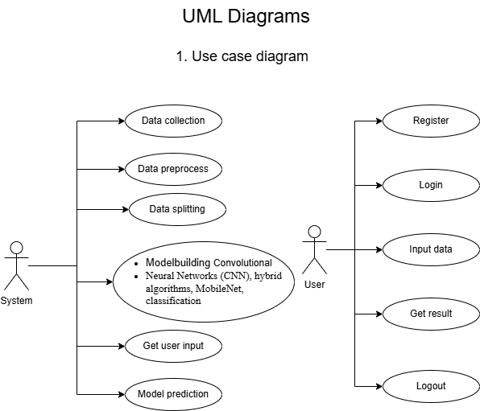
Figure: Use Case diagram

Slide 23
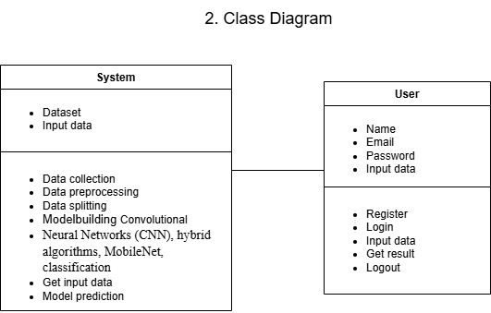
Class Diagram:
In software engineering, a class diagram in the Unified Modeling Language (UML) is a type of static structure diagram that describes the structure of a system by showing the system's classes, their attributes, operations (or methods), and the relationships among the classes. It explains which class contains information

Slide 24
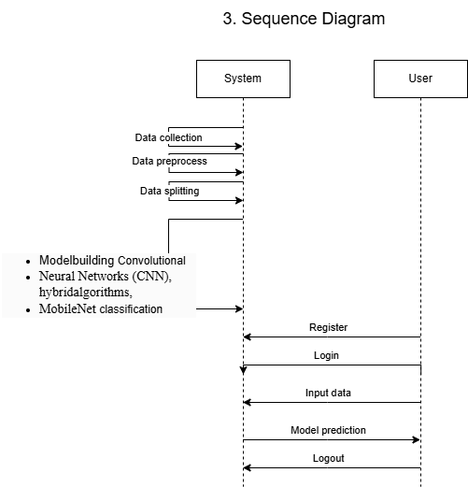
Sequence Diagram:
A sequence diagram in Unified Modeling Language (UML) is a kind of interaction diagram that shows how processes operate with one another and in what order.
It is a construct of a Message Sequence Chart. Sequence diagrams are sometimes called event diagrams, event scenarios, and timing diagrams
Figure: Sequence diagram

Slide 25
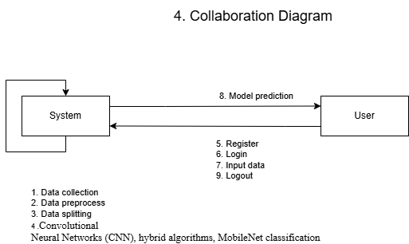
Collaboration Diagram:
In collaboration diagram the method call sequence is indicated by some numbering technique as shown below. The number indicates how the methods are called one after another. We have taken the same order management system to describe the collaboration diagram. The method calls are similar to that of a sequence diagram. But the difference is that the sequence diagram does not describe the object organization whereas the collaboration diagram shows the object organization.
Figure: Collaboration diagram

Slide 26
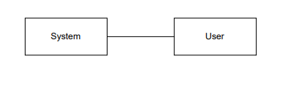
Deployment Diagram
Deployment diagram represents the deployment view of a system. It is related to the component diagram. Because the components are deployed using the deployment diagrams. A deployment diagram consists of nodes. Nodes are nothing but physical hardware’s used to deploy the application.
Figure: Deployment diagram

Slide 27
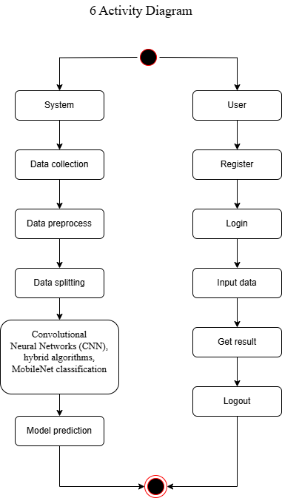
Activity Diagram:
Activity diagrams are graphical representations of workflows of stepwise activities and actions with support for choice, iteration and concurrency. In the Unified Modelling Language, activity diagrams can be used to describe the business and operational step-by-step workflows of components in a system. An activity diagram shows the overall flow of control.
Figure: Activity diagram

Slide 28
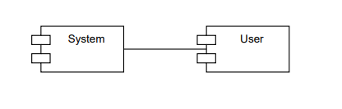
Component Diagram:
A component diagram, also known as a UML component diagram, describes the organization and wiring of the physical components in a system. Component diagrams are often drawn to help model implementation details and double-check that every aspect of the system's required function is covered by planned development.
Figure: Component diagram

Slide 29
    UML DIAGRAMS
ER Diagram:
An Entity–relationship model (ER model) describes the structure of a database with the help of a diagram, which is known as Entity Relationship Diagram (ER Diagram). An ER model is a design or blueprint of a database that can later be implemented as a database. The main components of E-R model are: entity set and relationship set.
An ER diagram shows the relationship among entity sets. An entity set is a group of similar entities and these entities can have attributes. In terms of DBMS, an entity is a table or attribute of a table in database, so by showing relationship among tables and their attributes, ER diagram shows the complete logical structure of a database. Let’s have a look at a simple ER diagram to understand this concept.

Slide 30
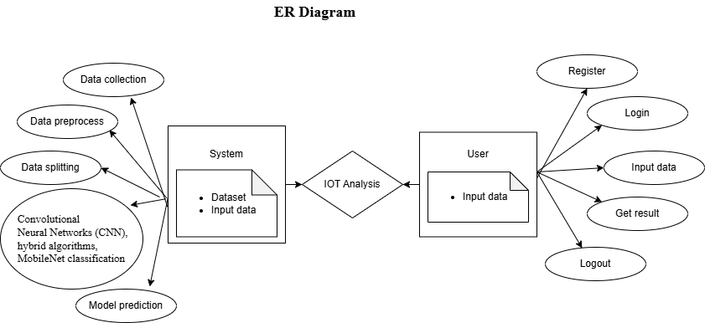
Figure: ER diagram

Slide 31
DFD Diagram:
A Data Flow Diagram (DFD) is a traditional way to visualize the information flows within a system. A neat and clear DFD can depict a good amount of the system requirements graphically. It can be manual, automated, or a combination of both. It shows how information enters and leaves the system, what changes the information and where information is stored. The purpose of a DFD is to show the scope and boundaries of a system as a whole. It may be used as a communications tool between a systems analyst and any person who plays a part in the system that acts as the starting point for redesigning a system.
dataset
system
user
Figure: Context Level diagram

Slide 32
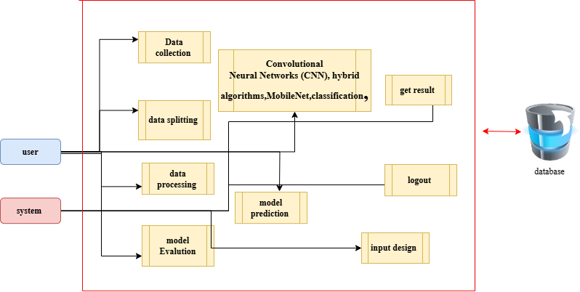
DFD Diagram:
Figure: Level 1 diagram

Slide 33
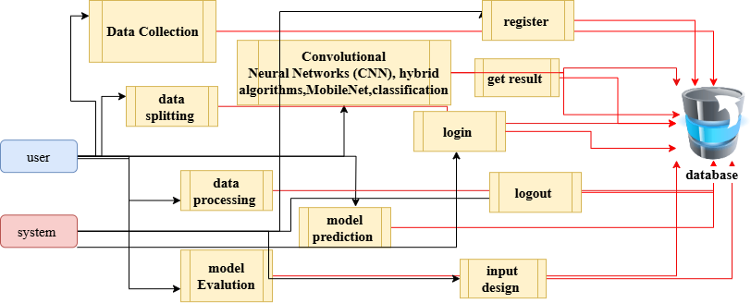
DFD Diagram:
Figure: Level 2 diagram

Slide 34
Implementation
Data Analysis
Model Implementation
01
Data Description
04
Working Process
02
Preprocessing steps
05
Results from Algorithm
03
Algorithm Definition

Slide 35
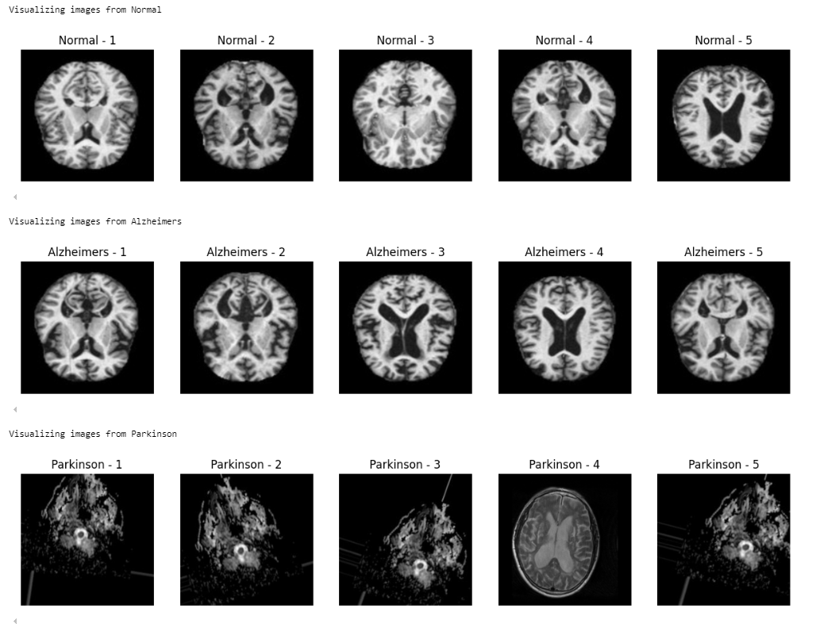
Data Description
Dataset :- https://www.kaggle.com/datasets/toshall/neurodegenerative-diseases
The dataset from Kaggle.
image description, here are the key points:
Data Overview: The dataset includes 3 primary folders: `normal` and `Parkinson` and “alzimers.
Clear Images: Contains a total of 7590 images that are likely high-quality, unobstructed views suitable for various applications like training models for image enhancement.

Slide 36
Pre-processing steps
Data Cleaning: Remove or impute missing values.
Feature Selection: Choose relevant features impacting hospital stay.
Data Transformation: Normalize or standardize numerical data.
Encoding Categorical Data: Use one-hot encoding or label encoding for categorical variables.
Data Splitting: Divide the dataset into training and testing sets.
Feature Engineering: Create new features that might improve model performance.

Slide 37
MODULES
1. User:
Input Model:
The user must provide input values for the certain fields in order to get results.
Upload dataset
View Results:
User view’s the generated results from the model.
View score:
Here user have ability to view the accuracy in %

Slide 38
2. System
2.1 Working on dataset: System checks for data whether it is available or not and load the data in csv files.
2.2 Pre-processing: Data need to be pre-processed according the models it helps to increase the accuracy of the model and better information about the data.
2.3 Training the data: After pre-processing the data will split into two parts as train and test data before training with the given algorithms.
2.4 Model Building: To create a model that predicts the personality with better accuracy, this module will help user.
2.5 Generated Score: Here user view the score in %

Slide 39
Algorithm Definition
Convolutional Neural Networks :
are a class of deep learning algorithms primarily used for image recognition, video analysis, and other tasks involving spatial data. A CNN is composed of several layers, including convolutional layers, pooling layers, and fully connected layers. The core idea behind a CNN is the convolution operation, which allows the model to learn features from input data (typically images) by applying filters (kernels) to extract important patterns such as edges, textures, and shapes. The convolutional layers perform these operations by sliding the filters over the image, creating feature maps.
Pooling layers, such as max pooling, follow the convolutional layers to reduce the spatial dimensions of the data, making the model computationally more efficient and resistant to overfitting. After several convolutional and pooling layers, the CNN typically ends with fully connected layers, where the extracted features are used for classification or regression tasks.

Slide 40
Algorithm Definition
2. Hybrid Algorithms:
Hybrid algorithms combine two or more different approaches to solve a problem, often to achieve better performance or efficiency than using a single algorithm. In machine learning, hybrid models can integrate different learning paradigms, such as combining supervised and unsupervised learning, or integrating optimization techniques like genetic algorithms with neural networks.
For example, a hybrid model might combine decision trees and neural networks, where decision trees are used for initial feature selection, and neural networks perform the classification task. The hybrid approach can balance the strengths of both techniques, such as the interpretability of decision trees with the high accuracy of deep learning models.In the context of optimization, hybrid algorithms might merge traditional gradient descent with evolutionary strategies to fine-tune the model’s parameters more effectively. By blending various methods, hybrid algorithms can leverage the complementary strengths of different models, improve generalization, and overcome limitations specific to individual techniques.

Slide 41
Algorithm Definition
3. MobileNet:
MobileNet is a family of lightweight deep learning models designed specifically for mobile and embedded devices. These networks prioritize efficiency, aiming to balance accuracy with computational resource constraints such as processing power and memory. The key innovation in MobileNet is the use of depthwise separable convolutions, which reduce the number of parameters and computations required compared to standard convolutions.
In a standard convolution, every input channel is connected to every output channel, which can result in a large number of operations. In depthwise separable convolutions, the convolution is split into two stages: a depthwise convolution, where each input channel is convolved separately, and a pointwise convolution (1x1 convolution) that combines these outputs. This significantly reduces computational cost while retaining high accuracy.

Slide 42
Algorithm Definition
3. Hybrid model (cnn+lstm):
A hybrid CNN-LSTM model combines the strengths of Convolutional Neural Networks (CNNs) and Long Short-Term Memory (LSTM) networks for tasks that involve both spatial and temporal data. CNNs are used to extract spatial features from images or sequential data, such as patterns or edges, while LSTMs capture long-term dependencies and temporal patterns in sequential data, such as time-series or video frames. This combination is effective for tasks like video classification, speech recognition, or image captioning, where CNN handles feature extraction and LSTM handles the sequential nature of the data, improving performance over using either model independently.

Slide 43
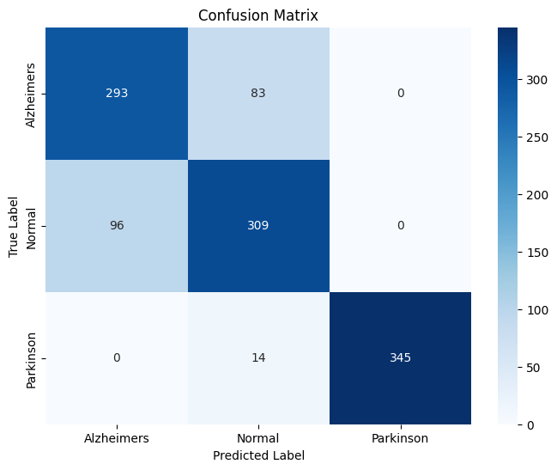
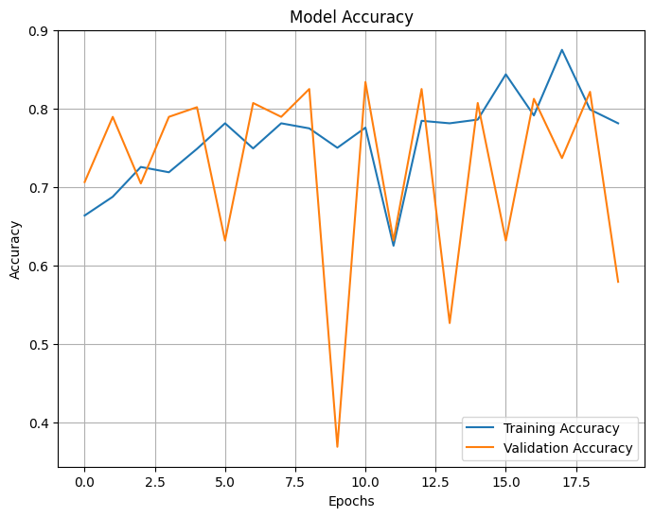
CNN model results:

Slide 44
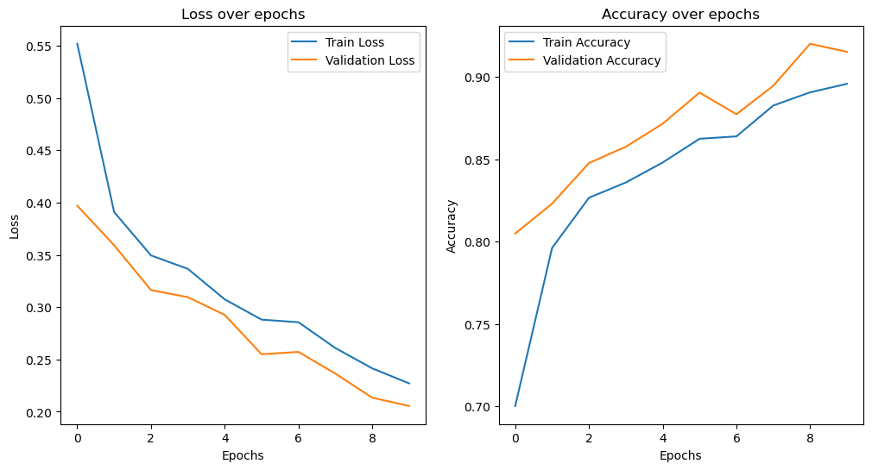
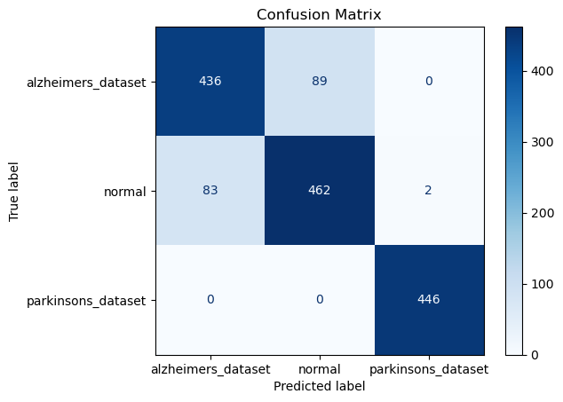
Mobile Net model results:

Slide 45
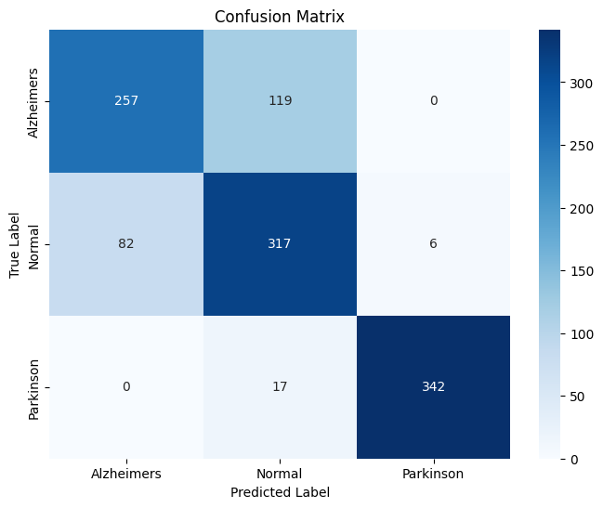
Hybrid model(CNN+LSTM)

Slide 46
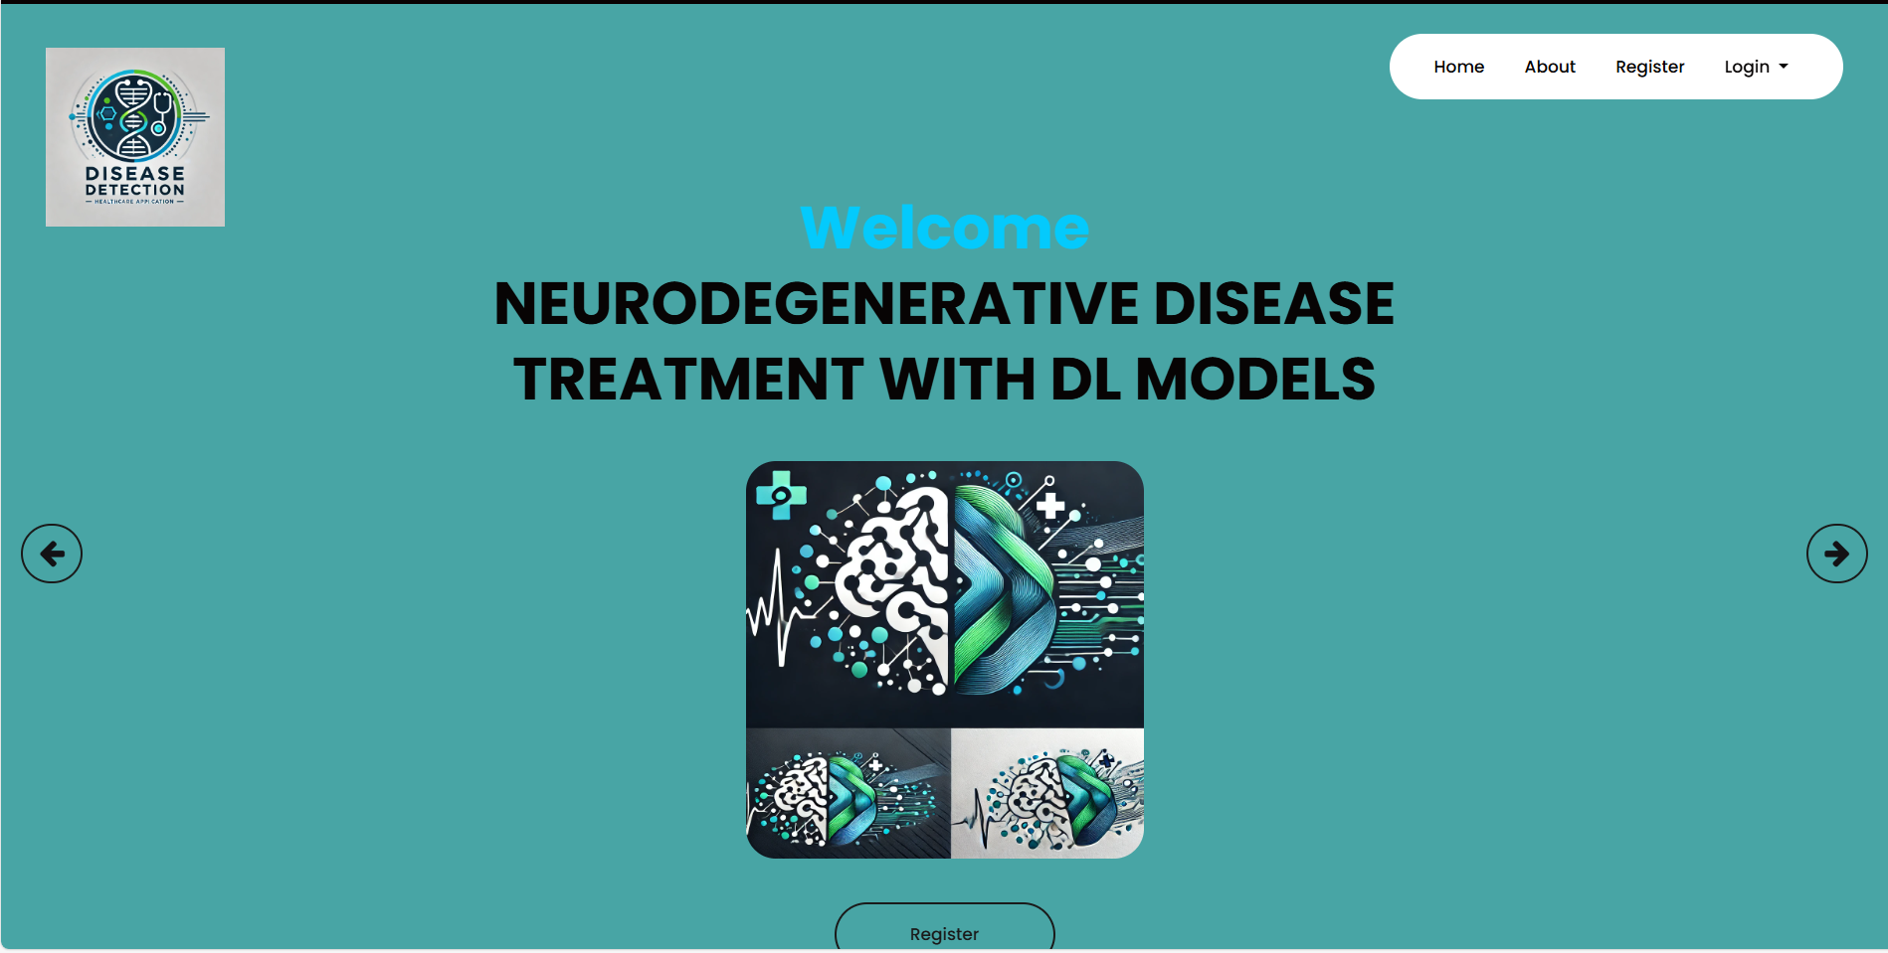
OUTPUT SCREEN SHOTS WITH DESCRIPTION.
Home Page: Home page of the project

Slide 47
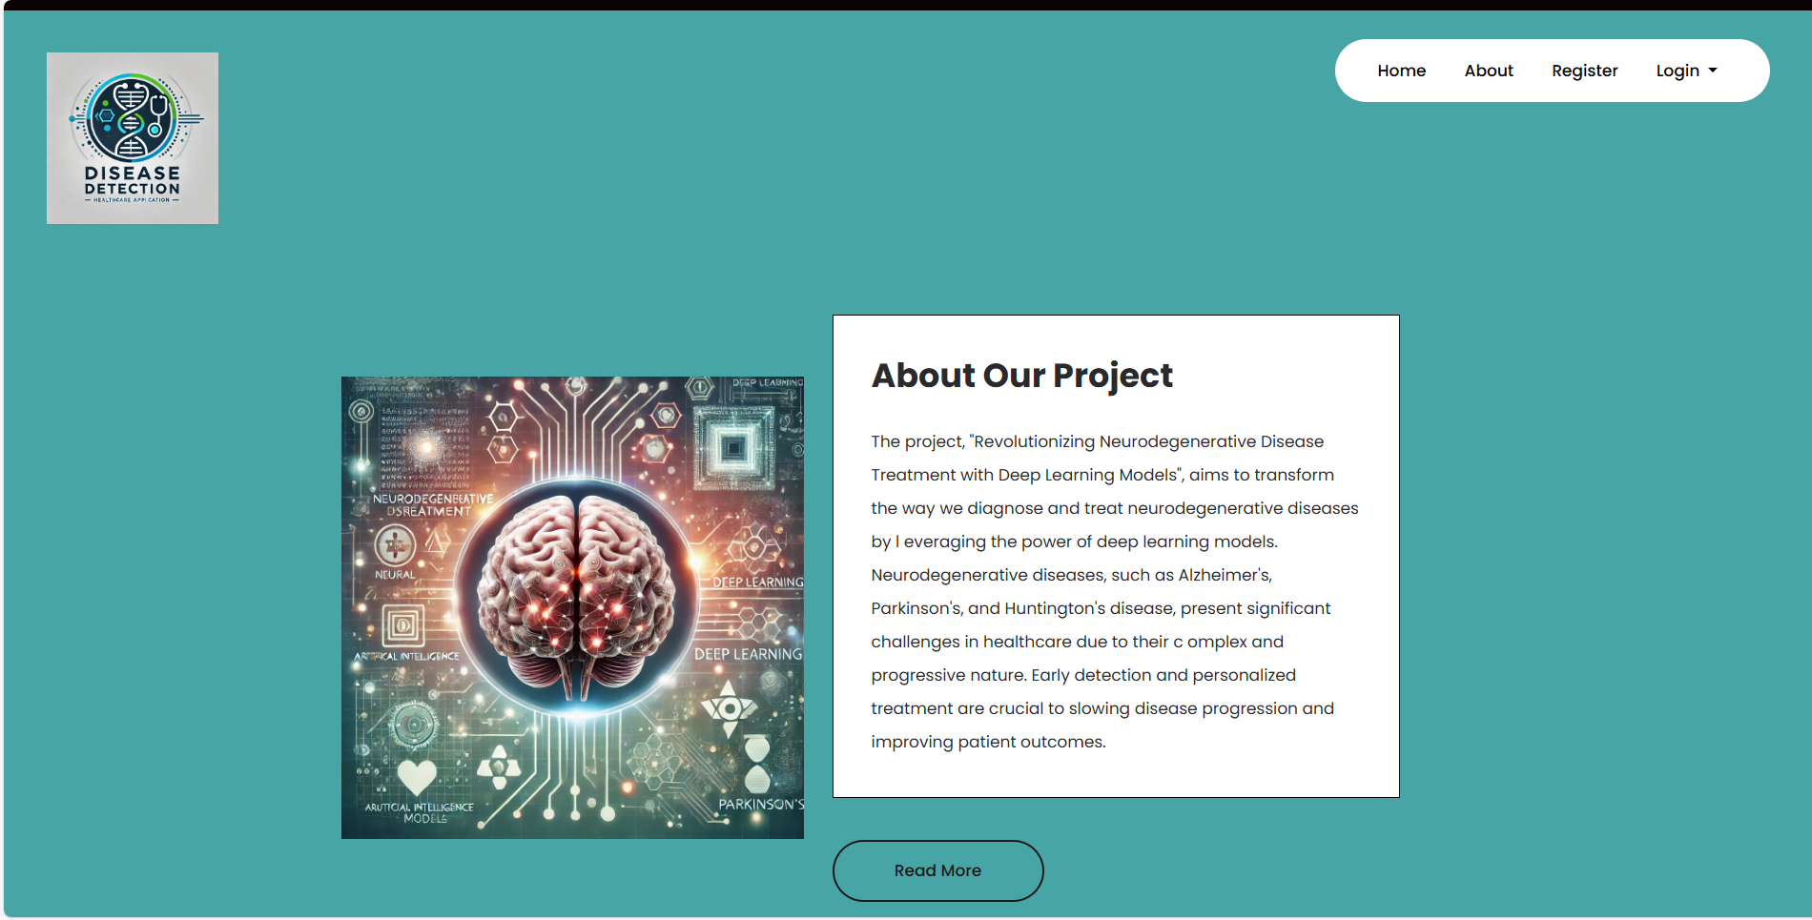
OUTPUT SCREEN SHOTS WITH DESCRIPTION.
about Page: About page of the project

Slide 48
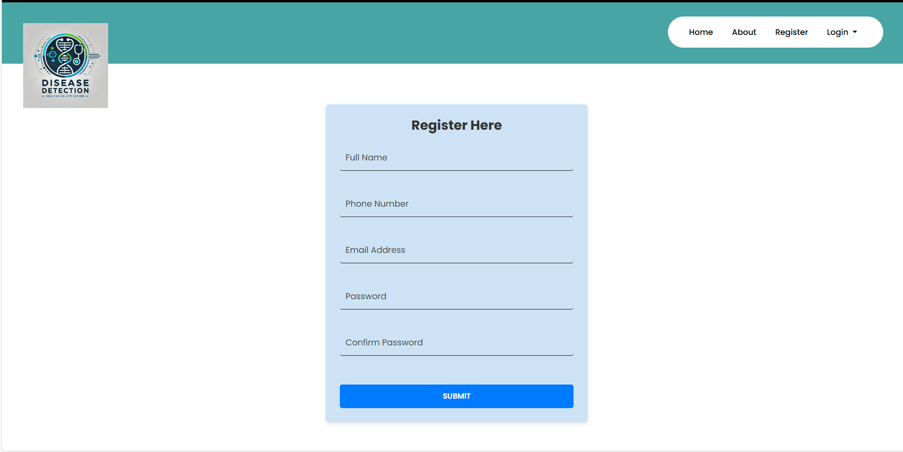
OUTPUT SCREEN SHOTS WITH DESCRIPTION.
Register Page: User can register here

Slide 49
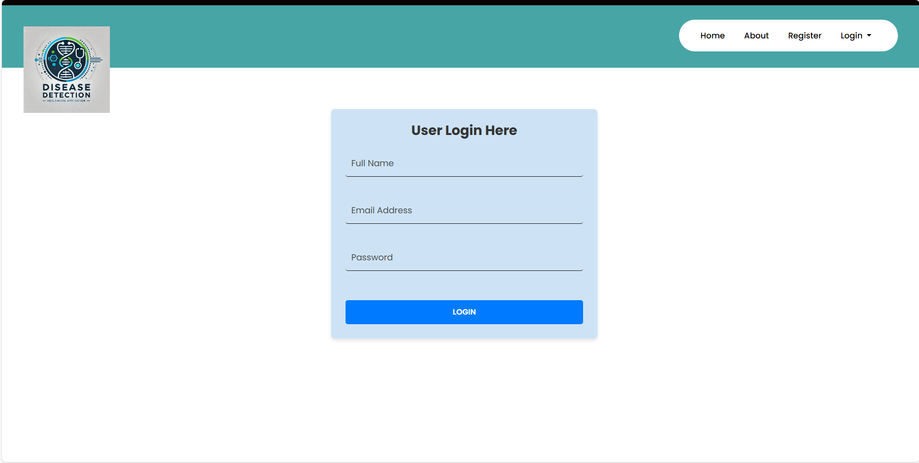
Login Page: Here user can provide their credential.

Slide 50
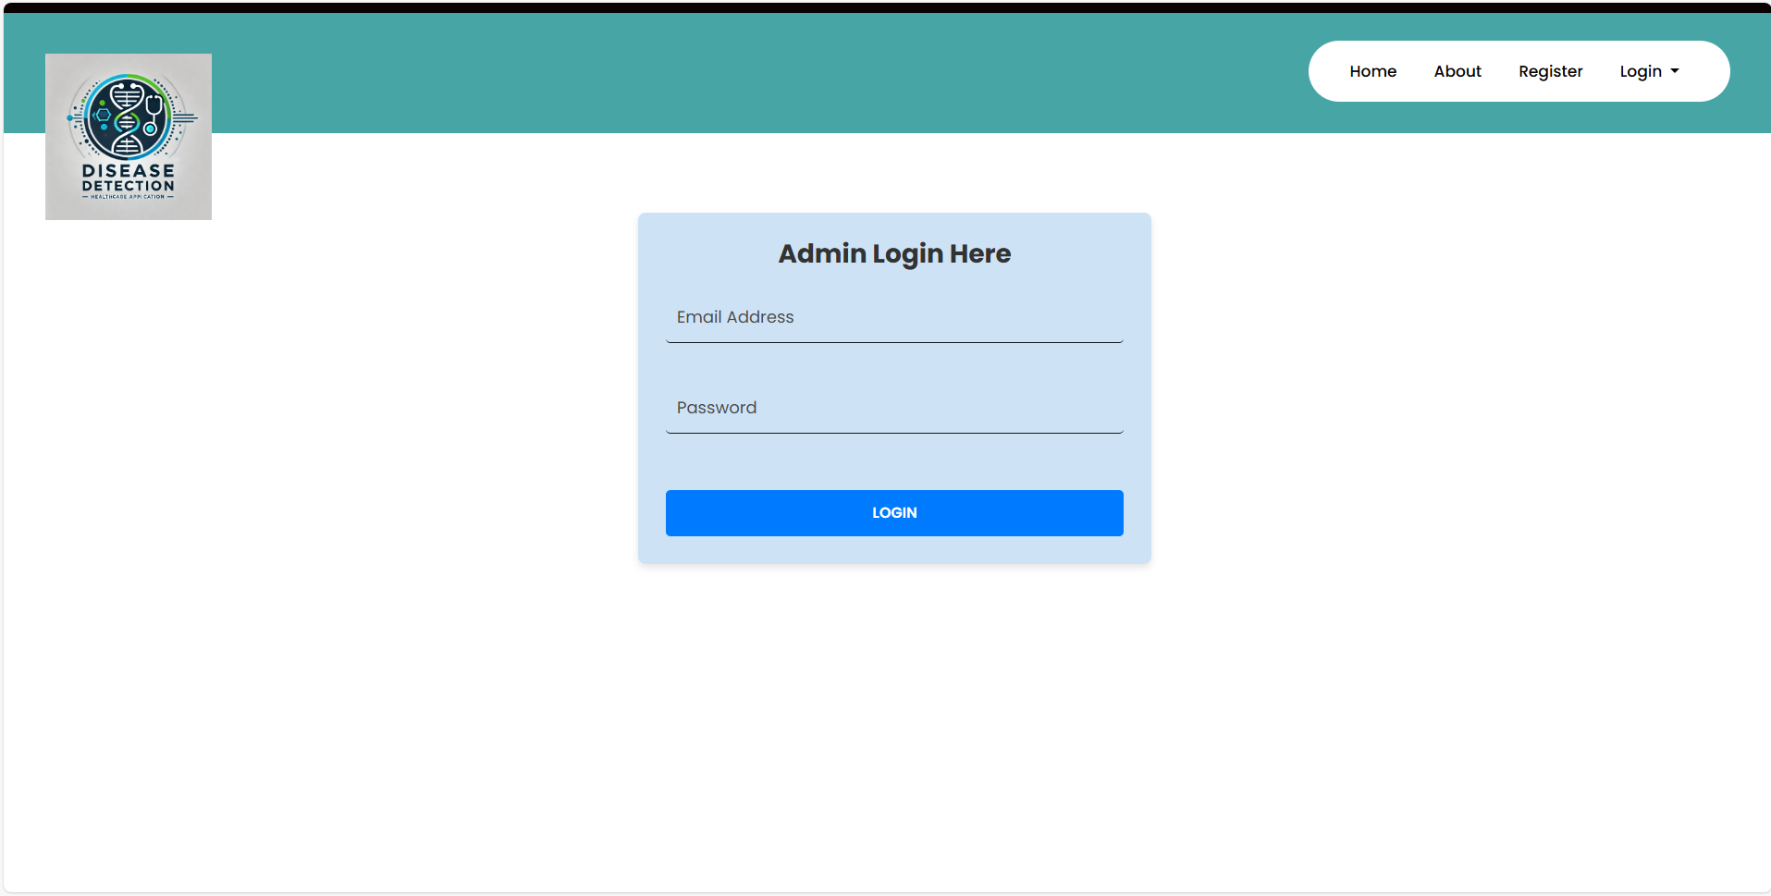
Admin login

Slide 51
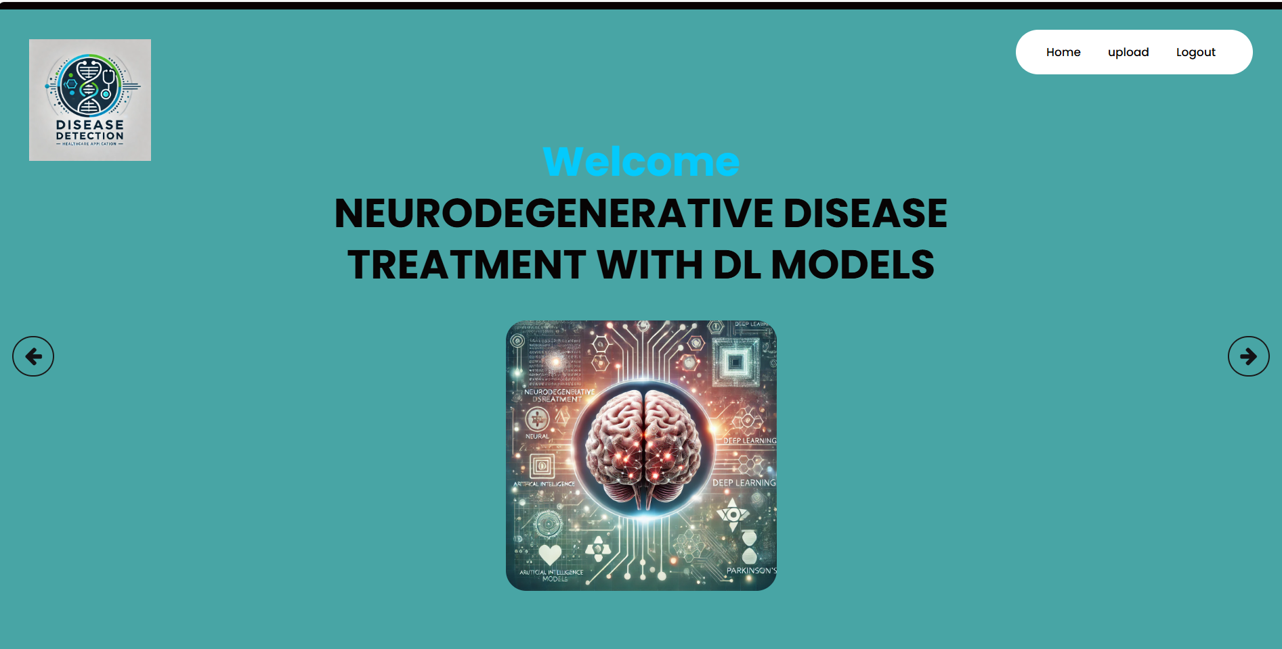
Model home page

Slide 52
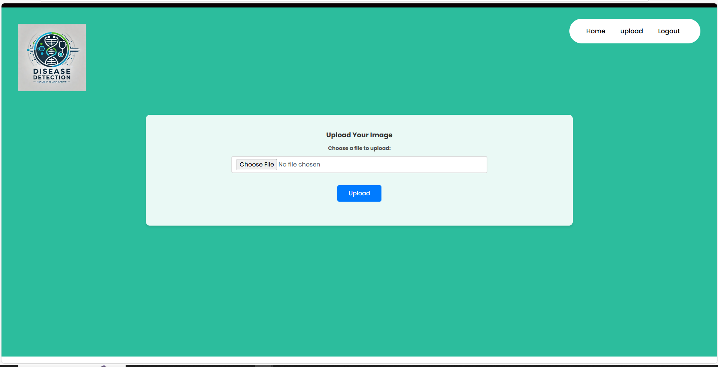
Prediction page .

Slide 53
CONCLUSION
The future of this research lies in further refining deep learning models for higher accuracy and broader applications in neurodegenerative diseases. Exploration of additional hybrid algorithms, including ensemble learning and reinforcement learning, could enhance model robustness and generalization across different datasets. Expansion into other neurological conditions, such as Alzheimer's and Parkinson's diseases, could provide comprehensive diagnostic tools. Integration with electronic health records (EHR) and wearable devices may offer real-time, continuous monitoring for better disease management. Moreover, optimization for edge computing environments can lead to real-time, on-site diagnostics. Collaborating with healthcare professionals will be key to translating these advancements into clinical practice, ensuring models are not only accurate but also aligned with medical standards and patient care protocols.

Slide 54
FUTURE SCOPE
The integration of deep learning models, specifically CNNs and hybrid algorithms, into the diagnosis and treatment of neurodegenerative diseases marks a transformative step in healthcare. The study highlights the potential of machine learning in classifying disease stages and types with high accuracy, facilitating early diagnosis and enabling personalized treatment. The use of advanced architectures like MobileNet optimizes the model for mobile and edge computing, offering accessibility in resource-constrained environments. This research paves the way for more efficient, scalable, and cost-effective solutions in healthcare, improving patient outcomes by leveraging AI-driven tools. As AI technology continues to evolve, it holds the promise of revolutionizing the approach to neurodegenerative diseases, making accurate diagnosis and personalized care more accessible and timely for patients worldwide.

Slide 55
REFERENCES
[1] Demirhan, A. (2016). "Classification of Structural MRI for Detecting Alzheimer’s Disease." International Journal of Intelligent Systems and Applications in Engineering, 4, 195–198. DOI: 10.18201/ijisae.2016SpecialIssue-146973
[2] Farooq, A., Anwar, S., Awais, M., & Alnowami, M. (2017). "Artificial intelligence-based smart diagnosis of Alzheimer’s disease and mild cognitive impairment." Proceedings of the International Smart Cities Conference (ISC2), Wuxi, China. DOI: 10.1109/ISC2.2017.8090834
[3] Martinez-Murcia, F. J., Gorriz, J. M., Ramirez, J., Castillo-Barnes, D., Segovia, F., Salas-Gonzalez, D., & Ortiz, A. (2018). "A Deep Decomposition of MRI to Explore Neurodegeneration in Alzheimer’s Disease." Proceedings of the IEEE Nuclear Science Symposium and Medical Imaging Conference Proceedings (NSS/MIC), Sydney, Australia. DOI: 10.1109/NSSMIC.2018.8824510
[4] Uysal, G., & Ozturk, M. (2020). "Classifying Early and Late Mild Cognitive Impairment Stages of Alzheimer’s Disease by Analyzing Different Brain Areas." Proceedings of the Medical Technologies Congress (TIPTEKNO), Antalya, Turkey. DOI: 10.1109/TIPTEKNO50054.2020.9299280

Slide 56
[6] Khatun, M., Islam, M. M., Rifat, H. R., Shahid, M. S. B., Talukder, M. A., & Uddin, M. A. (2024). "Hybridized Convolutional Neural Networks and Long Short-Term Memory for Improved Alzheimer's Disease Diagnosis from MRI Scans." arXiv preprint arXiv:2403.05353.
[6] Odimayo, S., Olisah, C. C., & Mohammed, K. (2024). "SNeurodCNN: Structure-focused Neurodegeneration Convolutional Neural Network for Modelling and Classification of Alzheimer's Disease." arXiv preprint arXiv:2401.03922.
[7] Rocheteau, E., & Kim, D. (2020). "Deep Transfer Learning for Automated Diagnosis of Skin Lesions from Photographs." arXiv preprint arXiv:2011.04475.
[8] Zhu, W., Qiu, P., Chen, X., Li, X., Lepore, N., Dumitrascu, O. M., & Wang, Y. (2023). "nnMobileNet: Rethinking CNN for Retinopathy Research." arXiv preprint arXiv:2306.01289.
[9] Signaevsky, M., Prastawa, M., Farrell, K., Tabish, N., Baldwin, E., & al. (2019). "Artificial intelligence in neuropathology: deep learning-based assessment of tauopathy." Laboratory Investigation.
[10] Zhang, Y., Wang, S., & Dong, Z. (2014). "Classification of Alzheimer Disease on Structural Magnetic Resonance Imaging by Kernel Support Vector Machine Decision Tree." Progress in Electromagnetics Research, 144, 171–184.

